Slide 1
Chapter 2
Mechanics of Futures Markets

Slide 2
Futures Contracts
specification
operation of margin accounts
organization of exchanges
regulation of markets
quote making
accounting

Slide 3
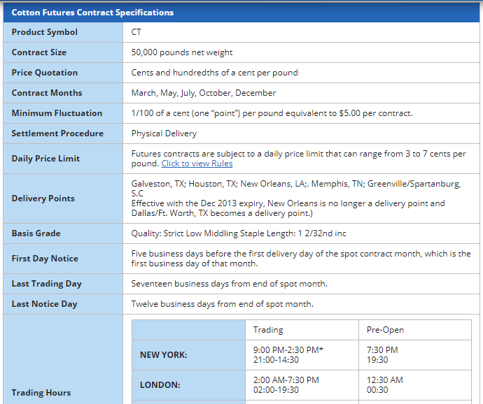
Futures Contract (e.g cotton futures)
Source:
https://www.danielstrading.com/education/markets/tropicals-softs/cotton-futures

Slide 4
Futures Contracts
Closing Out positions
Available on a wide range of assets
Contract size
Exchange traded
Specifications need to be defined:
  What can be delivered,
  Where it can be delivered, &
  When it can be delivered
Settled daily

Slide 5
Price Limits and Position Limits
PRICE LIMITS
Limit Down:
⇩ by the daily price limit
Limit Up:
⇧ by the daily price limit
Limit Move:
⇳ equal to the daily price limit
Purpose: speculative excess
POSITION LIMITS
are the maximum number of contracts that a speculator may hold.
Purpose: to prevent speculators from exercising undue influence on the market.

Slide 6
Convergence of Futures to Spot (Figure 2.1, page 29)
Futures
Price
Spot Price
Spot Price
Futures
Price
Time
Time
(a)
(b)

Slide 7
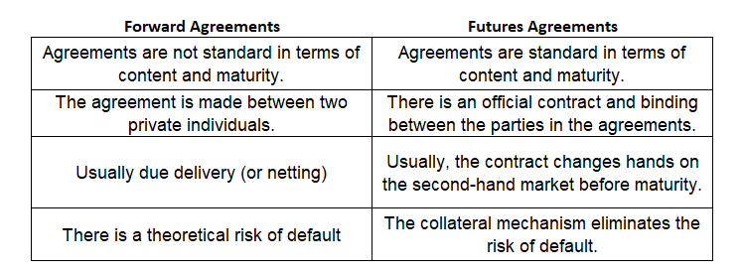
Differences between futures and forwards

Slide 8
Margins
A margin is cash or marketable securities deposited by an investor with his or her broker
The balance in the margin account is adjusted to reflect daily settlement
Margins minimize the possibility of a loss through a default on a contract

Slide 9
Margin Cash Flows
A trader has to bring the balance in the margin account up to the initial margin when it falls below the maintenance margin level
A member of the exchange clearing house only has an initial margin and is required to bring the balance in its account up to that level every day.
These daily margin cash flows are referred to as variation margin
A member is also required to contribute to a default fund
Margin Call

Slide 10
Initial Margin
Investors who will take both long and short positions in futures agreements have to give a certain percentage of their contracts to intermediary institutions in cash.
As a result of this guarantee, any investor holding a long or short position will not face any problems while realizing their profits at the end of the maturity date.
Generally it is stated by the organized exchange but
If it is not stated IM is σ (Variance) x 3
For example is σ = % 2 then IM is % 6

Slide 11
Example 1
Contract value : 2 TL
Underlying asset: SAHOL stock
Buys 50.000 unit
Variance ( σ )of the SAHOL is 2,5%
How much is the Initial Margin?

Slide 12
Example 2
If Initial Margin of a stock is 15.000 TL and the σ= %5,
what is the underlying asset size?
what is the value of one stock, if 1 contract is 100 unit?

Slide 13
Initial Margin
The very high initial margin received reduces the demand for these markets.
Calculation of the margin rate too low may also cause a risk of default in the futures transaction.
Initial margin can be increased during periods when the underlying asset and futures markets are very volatile.

Slide 14
Maintenance Margin
For example, the unit futures agreement value of 2 TL can reach 2.2 TL at the end of the day, or it can reach values such as 1.8 TL. In practice in the futures market, the price of the futures product is subject to a continuous daily evaluation. The process of continuously evaluating the collateral value with the forward product price is called "mark-to-market".

Slide 15
Example 3
Contract value : 2 TL
Underlying asset: SAHOL stock
Long 50.000 unit
1 day later value drops to 1,9 TL
Profit or Loss how much?

Slide 16
Example 4
Contract value : 100 $
Underlying asset: Nasdaq Index
Short 2.000 unit
1 day later value drops to 90 $
Profit or Loss how much?

Slide 17
Maintenance Margin
Such market movements may render collateral in the futures markets insufficient. Therefore, a second collateral structure is required. Usually 75% of the value of the initial margin is called the maintenance margin.
A mechanism has been developed to prevent the value of the investor's initial collateral from depreciating by more than 25%.

Slide 18
Example 5
If the initial margin of a futures contract is 9.000 TL, what is the maintenance margin?

Slide 19
Margin Call
In a futures contract, a margin call is made when the portfolio value falls below the maintenance margin.
In the valuation made at the end of the day, if the value of the collateral falls below the maintenance collateral, the intermediary institution calls the customer and asks for a certain amount of cash to be added to the collateral account.
This cash margin completion process requested from the customer is called “margin call".

Slide 20
Margin Call
The customer is obliged to deposit the amount between the current value of the collateral and the initial collateral into the collateral account in cash.
If the investor does not perform this transaction, the brokerage house may sell the investor's account to another customer.

Slide 21
Example 6
Initial Margin of a contract is 50.000 $
a. The value of a contract drops to half.
Is there a margin call? If yes, how much is the margin call amount?
b. The value of the contract drops to 40.000$
Is there a margin call? If yes, how much is the margin call amount?
c. The value of the contract drops by 40.000$
Is there a margin call? If yes, how much is the margin call amount?
d. The value of the contract drops by 10.000$
Is there a margin call? If yes, how much is the margin call amount?

Slide 22
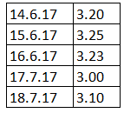
Example 7
At 14.06.2017, an investor is long at a 100.000 unit futures contract with a value of 3,2$. Initial Margin is 10%
Following occur per the dates:
What is the profit / loss per day?
What is the collateral account per day?

Slide 23
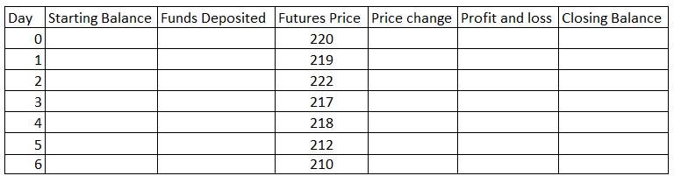
Example 8
The current price of a futures contract is 220 TL. In addition, the initial margin requirement per contract is 10 TL and the maintenance margin requirement is 8 TL. An investor buys 20 contracts and fills all margin calls.
When might the margin call come?
Complete the table below and describe the funds invested

Slide 24
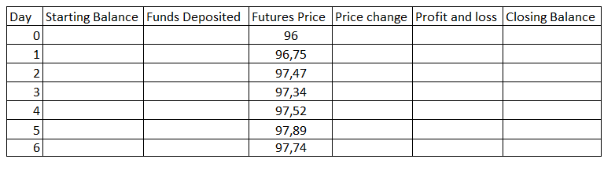
Example 9
An investor takes a short position on a futures contract on a bond with a 1.000 unit and price of TL 96. The initial margin (margin) requirement is TL 2,700 and the maintenance margin requirement is TL 2,000. This investor covers all margin calls.
Complete the table below and describe the funds invested.
What is the total profit or loss situation at the end of the 6th day?

Slide 25
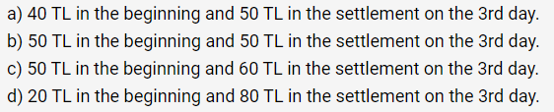
Example 10
An investor takes 20 short positions in a futures contract with a current price of 15 TL. The initial margin per contract is 2.50 TL and the maintenance margin is 2.00 TL per contract. Each contract is made on only 1 underlying asset. The contract price for the next 3 days is as follows, respectively: 16 TL, 14.25 TL and 15.5 TL. Within 3 days, this investor has not withdrawn any funds from the margin account, but has complied with the margin calls. Which of the following is true regarding the balance in the collateral account?

Slide 26
Example of a Futures Trade (page 27-29)
An investor takes a long position in 2 December gold futures contracts on June 5
  contract size is 100 oz.
  futures price is US$1,450
  initial margin requirement is US$6,000/contract (US$12,000 in total)
  maintenance margin is US$4,500/contract (US$9,000 in total)
%75

Slide 27
A Possible Outcome (Table 2.1, page 30)
Day | Trade Price ($) | Settle Price ($) | Daily Gain ($) | Cumul. Gain ($) | Margin Balance ($) | Margin Call ($)
1 | 1,450.00 |  |  |  | 12,000
1 |  | 1,441.00 | −1,800 | − 1,800 | 10,200
2 |  | 1,438.30 | −540 | −2,340 | 9,660
….. |  | ….. | ….. | ….. | ……
6 |  | 1,436.20 | −780 | −2,760 | 9,240
7 |  | 1,429.90 | −1,260 | −4,020 | 7,980 | 4,020
8 |  | 1,430.80 | 180 | −3,840 | 12,180
….. |  | ….. | ….. | ….. | ……
16 | 1,426.90 |  | 780 | −4,620 | 15,180
Value of 1 contract = 6.000 $
Value of 2 contracts = 12.000 $ IM
Price of 1 oz gold: 1.450$
At the end of day#1: drop by 9$
Daily loss: 9$ x 200 = 1.800 $
Margin balance = 12.000 – 1.800 = 10.200 $
At the end of day#2: drop by 2.7$
Daily loss: 2.7 x 200 = 540$
Margin balance = 10.200 – 540=
9.660 $
MM: 12.000 x 0,75 = 9.000 $
As it dropped to 7.980$
So complete to 12.000$
12.000$ – 7.980$ = 4.020 $ MC
IM: Initial Margin
MM: Maintenance Margin
MC: Margin Call

Slide 28
Margin Cash Flows When Futures Price Increases
Clearing House
Clearing House
Member
Clearing House
Member
Broker
Broker
Long Trader
Short Trader

Slide 29
Margin Cash Flows When Futures Price Decreases
Clearing House
Clearing House
Member
Clearing House
Member
Broker
Broker
Long Trader
Short Trader

Slide 30
Some Terminology
Open interest: the total number of contracts outstanding
  equal to number of long positions or number of short positions
Settlement price: the price just before the final bell each day
  used for the daily settlement process
Volume of trading: the number of trades in one day

Slide 31
Key Points About Futures
They are settled daily
Closing out a futures position involves entering into an offsetting trade
Most contracts are closed out before maturity

Slide 32
Crude Oil Trading on May 14, 2013 (Table 2.2, page 36)
 | Open | High | Low | Prior Settle | Last Trade | Change | Volume
Jun 2013 | 94.93 | 95.66 | 94.50 | 95.17 | 94.72 | −0.45 | 162,901
Aug 2013 | 95.24 | 95.92 | 94.81 | 95.43 | 95.01 | −0.42 | 37,830
Dec 2013 | 93.77 | 94.37 | 93.39 | 93.89 | 93.60 | −0.29 | 27,179
Dec 2014 | 89.98 | 90.09 | 89.40 | 89.71 | 89.62 | −0.09 | 9,606
Dec 2015 | 86.99 | 87.33 | 86.94 | 86.99 | 86.94 | −0.05 | 2,181

Slide 33
Clearing Houses and OTC Markets
Traditionally most transactions have been cleared bilaterally in OTC markets
Following the 2007-2009 crisis, the has been a requirement for most standardized OTC derivatives transactions between dealers to be cleared through central counterparties (CCPs)
CCPs require initial margin, variation margin, and default fund contributions from members similarly to exchange clearing houses

Slide 34
Collateralization in OTC Markets
It is becoming increasingly common for transactions to be collateralized in OTC markets
Bilateral Clearing
Consider transactions between companies A and B
These might be governed by an ISDA Master agreement with a credit support annex (CSA)

Slide 35
Collateralization in OTC Markets continued
If A defaults, B is entitled to take possession of the collateral
See Business Snapshot 2.2 for how collateralization affected Long Term Capital Management when there was a “flight to quality” in 1998.

Slide 36
A-----------------------------------B
CONTRACT (BILATERAL)
Value of the contract increases by X$ for A
Value of the contract decreases by X$ for B
In this case B has to provide collateral to A

Slide 37
Bilateral Clearing vs Central Clearing House

Slide 38
New Regulations
New regulations for trades between dealers that are not cleared centrally require dealers to post both initial margin and daily variation margin
The initial margin is posted with a third party

Slide 39
Delivery
If a futures contract is not closed out before maturity, it is usually settled by delivering the assets underlying the contract. When there are alternatives about what is delivered, where it is delivered, and when it is delivered, the party with the short position chooses.
“Notice of intention to deliver”
A few contracts (for example, those on stock indices and Eurodollars) are settled in cash

Slide 40
Questions
1- When a new trade is completed what are the possible effects on the open interest?
2- Can the volume of trading in a day be greater than the open interest?
Notes:
1- depending, on whether the trade is creating a new contract or closing out existing contracts, the open interest can either increase or decrease.
2- suppose you have 10 open contracts and you sell those to B and then B cells to C.. This increase the trading volume, but open interest remains same.

Slide 41
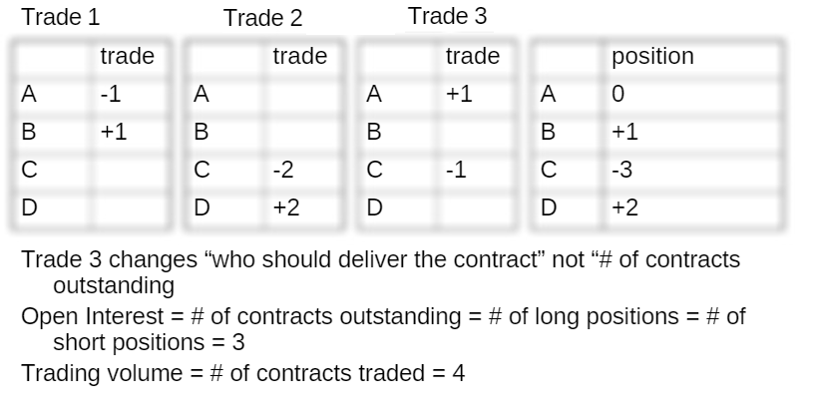

Slide 42
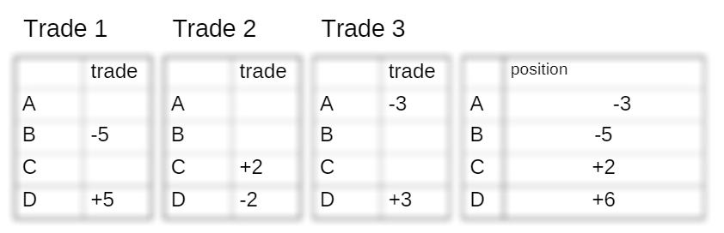
Trading volume, open interest=?
10 8

Slide 43
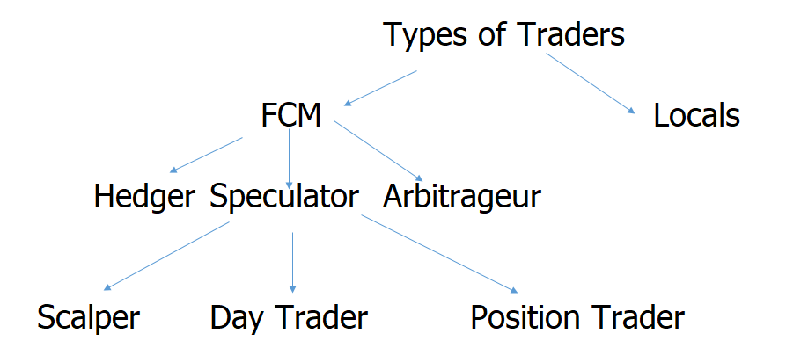
Types of Traders

Slide 44
Types of Orders
Limit
Stop
Stop-limit
Market-if touched
Discretionary
Time of day
Open
Fill or kill

Slide 45
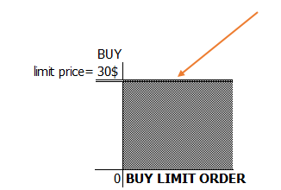
LIMIT ORDER

Slide 46
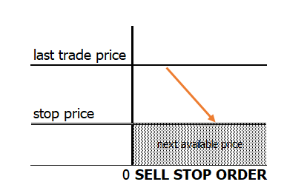
STOP ORDER
10$
5$

Slide 47
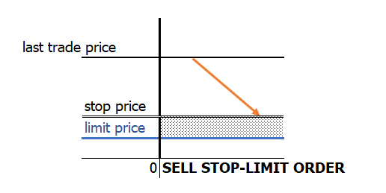
STOP-LIMIT ORDER
10$
5$
3$

Slide 48
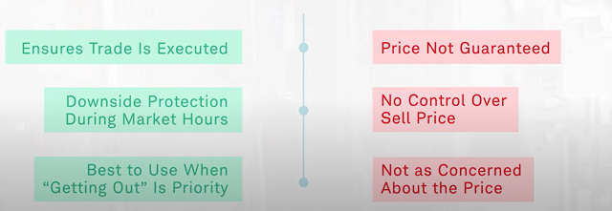
STOP ORDER

Slide 49
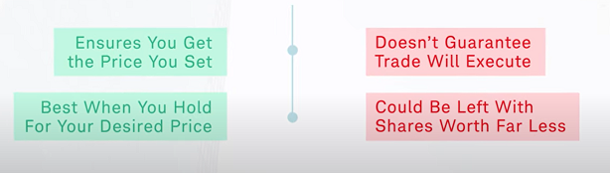
STOP-LIMIT ORDER

Slide 50
Regulation of Futures
In the US, the regulation of futures markets is primarily the responsibility of the Commodity Futures and Trading Commission (CFTC)
Regulators try to protect the public interest and prevent questionable trading practices

Slide 51
Accounting & Tax
Ideally hedging profits (losses) should be recognized at the same time as the losses (profits) on the item being hedged
Ideally profits and losses from speculation should be recognized on a mark-to-market basis
Roughly speaking, this is what the accounting and tax treatment of futures in the U.S. and many other countries attempt to achieve
1- Mark-to-market: 650c (Beginning) 670c (2014) 680c (2015 Feb)
5000 bushel
2014 : (670-650)x5.000 = 1.000 $
2015: (680-670)x5.000 = 500$
2- Hedge Accounting
2015 realization
(680-650)x5.000 = 1.500$
IAS39 / FASB 133

Slide 52
Forward Contracts vs Futures Contracts (Table 2.3, page 43)
FORWARDS
FUTURES
Private contract between 2 parties
Exchange traded
Non-standard contract
Standard contract
Usually 1 specified delivery date
Range of delivery dates
Settled at end of contract
Settled daily
Delivery or final cash
Contract usually closed out
settlement usually occurs
prior to maturity
Some credit risk
Virtually no credit risk
Notes:
16

Slide 53
Foreign Exchange Quotes
Futures exchange rates are quoted as the number of USD per unit of the foreign currency
Forward exchange rates are quoted in the same way as spot exchange rates. This means that GBP, EUR, AUD, and NZD are quoted as USD per unit of foreign currency. Other currencies (e.g., CAD and JPY) are quoted as units of the foreign currency per USD.
Notes:
17

