Slide 1
Chapter 1
Introduction

Slide 2
What is a Derivative?
A derivative is an instrument whose value depends on, or is derived from, the value of another asset.
Examples: futures, forwards,
swaps (credit default swaps), options, exotics…
TOO BIG TO FAIL
  AIG was compensated by the government by 85 mil $
Risk and Valuation

Slide 3
RISK
What is risk?
Underlying nature of the business (BUSINESS RISK)
  Such as: future sales / cost of inputs the FOUNDATIONS OF CAPITALISM!
Uncertainities
  Interest Rates, Stock Prices, Commodity Prices
  Exchange Rates.

Slide 4
Why Derivatives Are Important
Derivatives play a key role in transferring risks in the economy
The underlying assets include stocks, currencies, interest rates, commodities, debt instruments, electricity, insurance payouts, the weather, etc
Many financial transactions have embedded derivatives
The real options approach to assessing capital investment decisions has become widely accepted

Slide 5
How Derivatives Are Traded
1.Striking a deal
2.Clear (Specification)
3.Settle (Deliver)
4.Update records of ownership

Slide 6
How Derivatives Are Traded
On exchanges such as the Chicago Board Options Exchange (CBOE)
In the over-the-counter (OTC) market where traders working for banks, fund managers and corporate treasurers contact each other directly.
  Banks, other large financial institutions, fund managers, and corporations are the main participants in OTC derivatives markets

Slide 7
The OTC Market Prior to 2008
Largely unregulated
Banks acted as market makers quoting bids and offers
Master agreements usually defined how transactions between two parties would be handled
But some transactions were handled by central counterparties (CCPs). A CCP stands between the two sides to a transaction in the same way that an exchange does
CLEARING HOUSE

Slide 8
Since 2008…
OTC market has become regulated. Objectives:
  Reduce systemic risk (see Business
  Increase transparency
In the U.S and some other countries, standardized OTC products must be traded on swap execution facilities (SEFs) which are similar to exchanges
CCPs must be used for standardized transactions between dealers in most countries
All trades must be reported to a central registry (ch2. p.32)

Slide 9
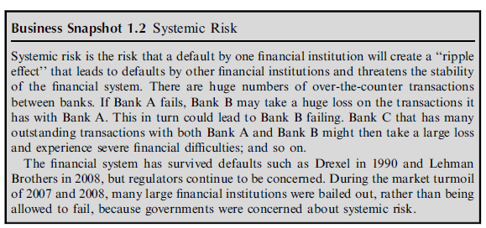

Slide 10
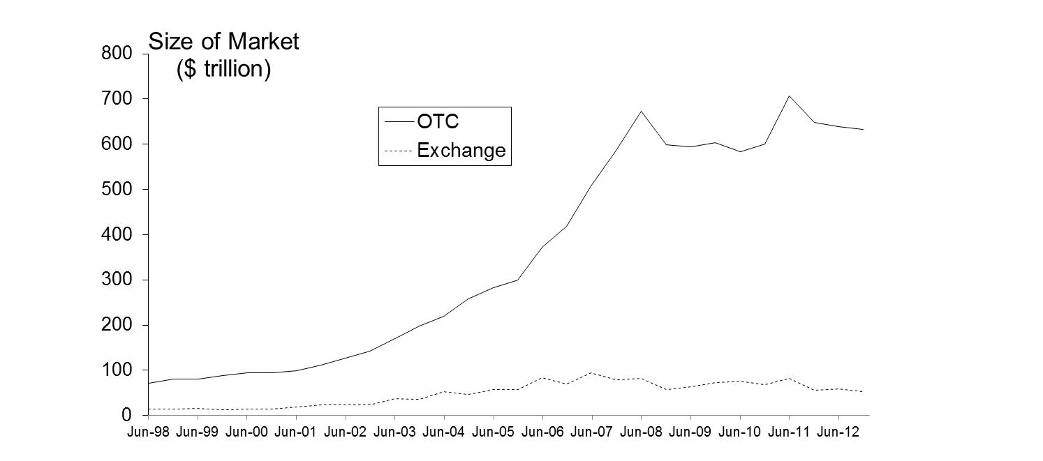
Size of OTC and Exchange-Traded Markets
(Figure 1.1, Page 5)
Source: Bank for International Settlements. Chart shows total principal amounts for OTC market and value of underlying assets for exchange market

Slide 11
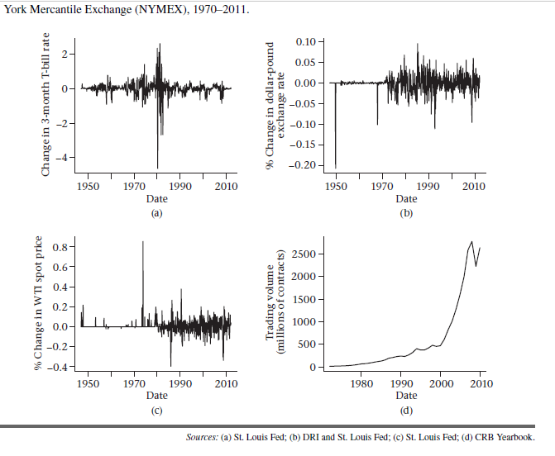

Slide 12
The Lehman Bankruptcy (Business Snapshot 1.1, pg. 4)
Lehman’s filed for bankruptcy on September 15, 2008. This was the biggest bankruptcy in US history
Lehman was an active participant in the OTC derivatives markets and got into financial difficulties because it took high risks and found it was unable to roll over its short term funding. What are other problems?
CRO vs CEO?
It had hundreds of thousands of transactions outstanding with about 8,000 counterparties. What is the effect/risk called as?

Slide 13
How Derivatives are Used
To hedge risks
To speculate (take a view on the future direction of the market)
Reduced transaction cost
To lock in an arbitrage profit
To change the nature of a liability
To change the nature of an investment without incurring the costs of selling one portfolio and buying another
Notes:
4

Slide 14
Foreign Exchange Quotes for GBP, May 26, 2013 (See page 6)
 | Bid | Offer
Spot | 1.5541 | 1.5545
1-month forward | 1.5538 | 1.5543
3-month forward | 1.5533 | 1.5538
6-month forward | 1.5526 | 1.5532

Slide 15
Forward Price
The forward price for a contract is the delivery price that would be applicable to the contract if were negotiated today (i.e., it is the delivery price that would make the contract worth exactly zero)
The forward price may be different for contracts of different maturities (as shown by the table)
Notes:
11

Slide 16
Terminology
The party that has agreed to buy has what is termed a long position
The party that has agreed to sell has what is termed a short position
Notes:
10

Slide 17
Example (page 6)
On May 6, 2013, the treasurer of a corporation enters into a long forward contract to buy £1 million in six months at an exchange rate of 1.5532
This obligates the corporation to pay $1,553,200 for £1 million on November 6, 2013
What are the possible outcomes?

Slide 18
 | Bid | Offer
Spot | 1.5541 | 1.5545
1-month forward | 1.5538 | 1.5543
3-month forward | 1.5533 | 1.5538
6-month forward | 1.5526 | 1.5532
Buy 1 million £ in the rate of 1,5532
Pays: 1.000.000 x 1,5532 = 1.553.200 $
If the rate was 1,60
Pays: 1.000.000 x 1,60 = 1.600.000 $
So gain is 1.600.000 – 1.553.200 = 46.800 $
If the rate was 1,50
Pays: 1.000.000 x 1,50 = 1.500.000 $
So lose is 1.500.000 – 1.553.200 = -53.200$ loss

Slide 19
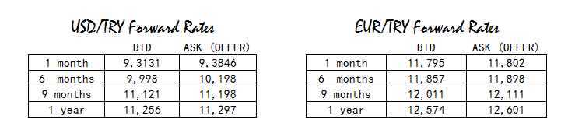
I am a pan producer, I bought 1 million USD steel (raw material) from the producer. I will pay that 6 months later.
Question 1: USD / TRY rate over 11,00 is ruining my financial position. So what should I do in order to hedge my financial position against if USD / TRY jumps up to 11,00?
Question 2: Should I go long or short?
Question 3: What happens if the rate jumps up to 11,00?
Question 4: What happens if the rate stays at 9,50?
Question 5: Draw the graphic of the outcomes.
A

Slide 20
I am a hygenic material seller, I sell 1 million EUR hygenic products to Iraq. The buyer will pay that 6 months later.
Question 1: EUR / TRY rate under 11,00 is not aligned with my profit intentions. So what should I do in order to hedge my financial position against if EUR / TRY stays under 11,00?
Question 2: Should I go long or short?
Question 3: What happens if the rate jumps up to 13,00?
Question 4: What happens if the rate stays at 10,00?
Question 5: Draw the graphic of the outcomes.
B

Slide 21
I am buying natural gas from Russia in terms of 3 billion USD. I am pretty sure that USD will stay safe against TRY won’t rise that much. So I made a 1 month deal.
Question 1: 9,30 is bearable for my economy. What should I do?
Question 2: Should I go long or short?
Question 3: What happens if the rate jumps up to 10,00?
Question 4: What happens if the rate stays at 9,20?
Question 5: Draw the graphic of the outcomes.
C

Slide 22
I am selling tomato to Thailand in terms of 27.500 USD. Our arrangement’s due date is 1 year.
Question 1: I don’t want to stay down under 11,00. What should I do?
Question 2: Should I go long or short?
Question 3: What happens if the rate raise up to 12,00?
Question 4: What happens if the rate raise up to 10,50?
Question 5: Draw the graphic of the outcomes,
Question 6: Indicate minimum and maximum loss.
Question 7: Indicate maximum profit.
Question 8: At which price(s) │loss – profit │= 0
D

Slide 23
Profit
6.000
4,75
Price of Underlying at Maturity, S_{T}
K
5,50
9.000
1. What is the position?
2. Per 12.000 USD / Dinar What is K?
3. Intersection of Profit Axis=?
E

Slide 24
Profit
9.250
Price of Underlying
at Maturity, S_{T}
41,00
1,00
K
30.750
1. What is the position?
2. Per 1.000 USD What is K?
3. Verify that your solution for K is correct.
4. Intersection of Profit Axis=?
5. What can be the maturity?
F

Slide 25
Profit
1.000
1,90
Price of Underlying at Maturity, S_{T}
K
2,15
4.000
Do in this order of questions (use geometric model)
1. What is the position?
2. Intersection of Profit Axis=?
3. What is K?
4. What is Underlying Asset Quantity?
G

Slide 26
Profit
12.000
Price of Underlying
at Maturity, S_{T}
10,00
9,00
K
18.000
Do in this order of questions (use geometric model)
1. What is the position?
2. Intersection of Profit Axis=?
3. What is K?
4. What is Underlying Asset Quantity?
5. Verify (reconcile) your answers
H

Slide 27
Profit from a Long Forward Position (K= delivery price=forward price at time contract is entered into)
Profit
46.800
Price of Underlying at Maturity, S_{T}
1,50
1,60
K
=1,5532
-53.200
Notes:
14

Slide 28
Profit from a Short Forward Position (K= delivery price=forward price at time contract is entered into)
Profit
53.200
1,50
Price of Underlying
at Maturity, S_{T}
1,60
K
=1,5532
-46.800
Notes:
15

Slide 29
In general, the payoff from a long position in a forward contract on one unit of an asset is
ST- K
where K is the delivery price and ST is the spot price of the asset at maturity of the contract. This is because the holder of the contract is obligated to buy an asset worth ST for K.
Similarly, the payoff from a short position in a forward contract on one unit of an asset is
K - ST

Slide 30
Futures Contracts (page 8)
Agreement to buy or sell an asset for a certain price at a certain time
Similar to forward contract
Whereas a forward contract is traded OTC, a futures contract is traded on an exchange

Slide 31
Exchanges Trading Futures
CME Group (formed when Chicago Mercantile Exchange and Chicago Board of Trade merged)
NYSE Euronext (being acquired by the InterContinental Exchange)
BM&F (Sao Paulo, Brazil)
TIFFE (Tokyo)
and many more (see list at end of book)

Slide 32
VIOP
https://www.borsaistanbul.com/en/sayfa/3072/futures

Slide 33
Examples of Futures Contracts
Agreement to:
  Buy 100 oz. of gold @ US$1400/oz. in December
  Sell £62,500 @ 1.5500 US$/£ in March
  Sell 1,000 bbl. of oil @ US$90/bbl. in April
1
2
3
LONG
SHORT
LONG
Which one is different sides?
Answer: 3
There is 1 buyer and 1 seller on the 3rd one
For 1st; there is only 1 buyer
For 2nd there is only 1 seller
Notes:
9

Slide 34
1. Gold: An Arbitrage Opportunity?
Suppose that:
  The spot price of gold is US$1,400
  The 1-year forward price of gold is US$1,500
  The 1-year US$ interest rate is 5% per annum
Is there an arbitrage opportunity?
The real forward price= 1.400 x 1,05= 1.470
Buy the spot = 1.400
Borrow = 1.400
Short forward = 1.500
Cost of borrow = 1.470
Profit => 1.500 – 1.470 = 30 $
Notes:
18

Slide 35
2. Gold: Another Arbitrage Opportunity?
Suppose that:
  The spot price of gold is US$1,400
  The 1-year forward price of gold is US$1,400
  The 1-year US$ interest rate is 5% per annum
Is there an arbitrage opportunity?
Real Forward Price = 1.400 x 1,05 = 1.470
Short spot = 1.400
Invest = 1.400
Long forward = 1.400
Invest : 1.400 x 1,05 = 1.470
Profit => 1.470 – 1.400 = 70$
Notes:
19

Slide 36
The Forward Price of Gold (ignores the gold lease rate)
If the spot price of gold is S and the forward price for a contract deliverable in T years is F, then
F = S (1+r )^{T}
where r is the 1-year (domestic currency) risk-free rate of interest.
In our examples, S = 1400, T = 1, and r =0.05 so that
F = 1400(1+0.05) = 1470
Notes:
20

Slide 37
1. Oil: An Arbitrage Opportunity?
Suppose that:
  The spot price of oil is US$95
  The quoted 1-year futures price of oil is US$125
  The 1-year US$ interest rate is 5% per annum
  The storage costs of oil are 2% per annum
Is there an arbitrage opportunity?
Calculate over storage cost added:
=(1+0,05+0,02)
= (1,07)
…
Notes:
21

Slide 38
2. Oil: Another Arbitrage Opportunity?
Suppose that:
  The spot price of oil is US$95
  The quoted 1-year futures price of oil is US$80
  The 1-year US$ interest rate is 5% per annum
  The storage costs of oil are 2% per annum
Is there an arbitrage opportunity?
Calculate over storage cost added:
=(1+0,05+0,02)
= (1,07)
…
Notes:
22

Slide 39
Options (pg.8)
A call option is an option to buy a certain asset by a certain date for a certain price (the strike price)
A put option is an option to sell a certain asset by a certain date for a certain price (the strike price/exercise price)

Slide 40
American vs European Options
An American option can be exercised at any time during its life
A European option can be exercised only at maturity
Eurodollar / Eurobond=?

Slide 41
Google Call Option Prices from CBOE (May 8, 2013; Stock Price is bid 871.23, offer 871.37); See Table 1.2 page 9
Strike Price | Jun 2013 Bid | Jun 2013 Offer/Ask | Sep 2013 Bid | Sep 2013 Offer/Ask | Dec 2013 Bid | Dec 2013 Offer/Ask
820 | 56.00 | 57.50 | 76.00 | 77.80 | 88.00 | 90.30
840 | 39.50 | 40.70 | 62.90 | 63.90 | 75.70 | 78.00
860 | 25.70 | 26.50 | 51.20 | 52.30 | 65.10 | 66.40
880 | 15.00 | 15.60 | 41.00 | 41.60 | 55.00 | 56.30
900 | 7.90 | 8.40 | 32.10 | 32.80 | 45.90 | 47.20
920 | n.a. | n.a. | 24.80 | 25.60 | 37.90 | 39.40
Ü880$ Cost : 56,30
1 option contract = 100 share
56,30 x 100 = 5.630 $
Profit occurs above 880$
@1.000 $
Payoff => 1.000 – 880 = 120$
120$ x 100 share = 12.000 $
Profit = 12.000 – 5.630 = 6.370$

Slide 42
Google Put Option Prices from CBOE (May 8, 2013; Stock Price is bid 871.23, offer 871.37); See Table 1.3 page 9
Strike Price | Jun 2013 Bid | Jun 2013 Offer | Sep 2013 Bid | Sep 2013 Offer | Dec 2013 Bid | Dec 2013 Offer
820 | 5.00 | 5.50 | 24.20 | 24.90 | 36.20 | 37.50
840 | 8.40 | 8.90 | 31.00 | 31.80 | 43.90 | 45.10
860 | 14.30 | 14.80 | 39.20 | 40.10 | 52.60 | 53.90
880 | 23.40 | 24.40 | 48.80 | 49.80 | 62.40 | 63.70
900 | 36.20 | 37.30 | 59.20 | 60.90 | 73.40 | 75.00
920 | n.a. | n.a. | 71.60 | 73.50 | 85.50 | 87.40
Ü840$ cost : 31,80$
100 share: 31,80 x 100 = 3.180 $
Profit occurs below 840$
@800$
Payoff = 840-800 = 40$
100 share => 100 x 40 = 4.000 $
Profit = 4.000$ – 3.180 $ = 820 $

Slide 43
Options vs Futures/Forwards
A futures/forward contract gives the holder the obligation to buy or sell at a certain price
An option gives the holder the right to buy or sell at a certain price
Cost difference, which is costly?

Slide 44
Types of Traders
Hedgers
Speculators
Arbitrageurs
Notes:
15

Slide 45
Hedging Examples (pages 11-13)
A US company will pay £10 million for imports from Britain in 3 months and decides to hedge using a long position in a forward contract
An investor owns 1,000 Microsoft shares currently worth $28 per share. A two-month put with a strike price of $27.50 costs $1. The investor decides to hedge by buying 10 contracts
Notes:
16

Slide 46
Value of Microsoft Shares with and without Hedging (Fig 1.4, page 13)
1.000 $ cost

Slide 47
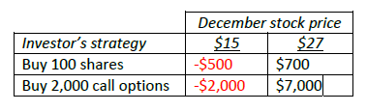
Speculation Example
An investor with $2,000 to invest feels that a stock price will increase over the next 2 months. The current stock price is $20 and the price of a 2-month call option with a strike of 22.50 is $1
What are the alternative strategies?
- Strategy 1: purchase 100 shares: if stock price goes to $27
100 x ($27 - $20) = $700
- Strategy 2: purchase 2,000 call options (20 call option contracts):
2,000 x ($27 – $22.50- = $9,000
Subtract the cost of the options ($1/option):
$9,000 - $2,000 = $7,000
The profit is far greater, but the loss can be greater as well: suppose stock price goes to $15
Strategy 1: 100 x ($15 - $20): - $500
Strategy 2: you won’t exercise the option, but you lose the costs: - $2,000
Notes:
17

Slide 48
Arbitrage Example
A stock price is quoted as £100 in London and $150 in New York
The current exchange rate is 1.4300
What is the arbitrage opportunity?
Buy 100 shares in New York @ $140
Sell 100 shares in London @ £100
Payoff: 100 x (+100 x 1.4300 - $140) = $300
However: transaction costs would probably eliminate the profit for a small investor.

Slide 49
Dangers
Traders can switch from being hedgers to speculators or from being arbitrageurs to speculators
It is important to set up controls to ensure that trades are using derivatives in for their intended purpose
Soc Gen (see Business Snapshot 1.4 on page 18) is an example of what can go wrong

Slide 50
Hedge Funds (see Business Snapshot 1.3, page 12)
Hedge funds are not subject to the same rules as mutual funds and cannot offer their securities publicly.
Mutual funds must
  disclose investment policies,
  makes shares redeemable at any time,
  limit use of leverage
Hedge funds are not subject to these constraints.
Hedge funds use complex trading strategies are big users of derivatives for hedging, speculation and arbitrage

Slide 51
Types of Hedge Funds
Long/Short Equities
Convertible Arbitrage
Distressed Securities
Emerging Markets
Global Macro
Merger Arbitrage

