Slide 1
IRE … Turkish Foreign Policy
Assist. Prof. Saffet Akkaya
Course hours: ???
saffetakkaya@cag.edu.tr
Week 12: Turkish Foreign Policy During Cold War (1960-1980)

Slide 2

Main Source for the Course
Türk Dış Politikası Vol 1, 2, 3
Ed. Baskın Oran
Türk Dış Politikası Vol 1: Pages 655-714

Slide 3
International Environment and Dynamics in the 1960s
During this period, the bipolar world order continued. However, a détente also began to emerge.
The reason becomes clear as the daunting power of nuclear weapons and the acceptance by both poles of the existing balance and status quo.
Three cornerstones emerged within this détente process:
  a. Mutual and balanced force reductions (détente),
  b. Conference on Security and Co-operation in Europe (CSCE-1973/OSCE-1994),
  c. Helsinki Final Act (1975)

Slide 4
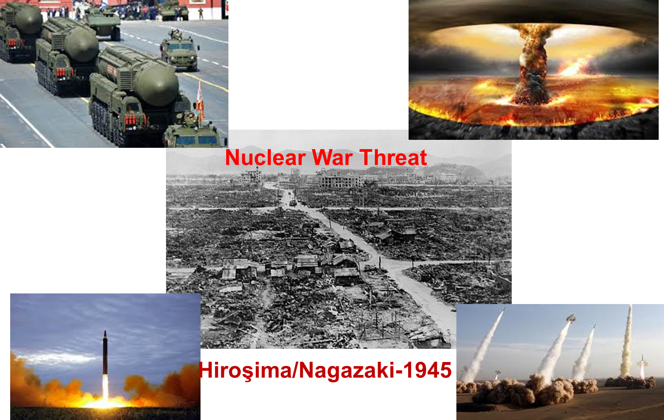
International Environment and Dynamics in the 1960s

Slide 5
International Environment and Dynamics in the 1960s
Détente/Détente is a policy that envisions a gradual and deliberate reduction of tension between countries or groups of countries with different economic and social systems, ultimately leading to peaceful coexistence, long-term, and comprehensive cooperation, subject to a sufficient number of conditions.
SALT 1 TREATY (Strategic Arms Limitation Talks): This is the first treaty on the limitation of nuclear weapons. The Détente Period began with SALT 1.
SALT 2 TREATY: Negotiations began in Geneva in 1972 and concluded in Vienna in 1979.
HELSINKI Final Act: As a result of the East-West détente, the Conference on Security and Co-operation in Europe (CSCE) convened in 1973. The Helsinki Final Act was signed by 33 European countries, excluding Albania, the United States, and Canada. Accordingly, the parties were to ensure cooperation in economic, security, and social areas, and to exchange information.

Slide 6
International Environment and Dynamics in the 1960s
HELSINKI Final Act: As a result of the East-West détente, the Conference on Security and Co-operation in Europe (CSCE) convened in 1973. The Helsinki Final Act was signed by 33 European countries, excluding Albania, the United States, and Canada. Accordingly, the parties were to ensure cooperation in economic, security, and social areas, and to exchange information.
The Helsinki Final Act contained three baskets:
  The Security and Registration Basket, desired by the USSR;
  The Human Rights Basket, desired by the US-West;
  The Economic-Scientific-Environmental Cooperation Basket (Joint).
The signing of the Helsinki Final Act, which resulted in complete agreement, created new dynamics.

Slide 7
International Environment and Dynamics in the 1960s
Important events between 1960 and 1980:
  1956 Hungarian Uprising
  1968 Prague Uprising
  1973 Vietnam War and US Defeat
  1973 Oil Embargo ($3-30)
  1979 USSR Invasion of Afghanistan
  1979 Iranian Revolution

Slide 8
International Environment and Dynamics in the 1960s
During this period, the United States experienced a relative loss of power.
Reasons:
  The Vietnam debacle,
  The collapse of the Bretton Woods System,
  The economic rise of Germany and Japan,
  The presidential crisis in the United States and Nixon's resignation,
  The loss of the Shah in Iran,
  The loss of Afghanistan to the USSR.

Slide 9
International Environment and Dynamics in the 1960s
During this period, the USSR gained relative power.
Reasons:
  Its economic aid to the Warsaw Pact and Comecon,
  Its acquisition of satellite states and bases in the Middle East,
  Its strengthening of its naval forces and aircraft carriers,
  Its intervention in Afghanistan and its approach to the Indian Ocean.

Slide 10
Internal Environment and Dynamics of Türkiye
This period encompassed a period of turbulent domestic and foreign policy, encompassing the period between the 1960 military coup, the 1971 military coup, and the 1980 military coup.
Let's first examine economic indicators. Generally, there was stability and growth until the 1970s, but from 1973 onward, economic indicators, including inflation, the import/export balance, foreign debt, and the US dollar exchange rate, experienced problems.
The 1973 oil crisis also played a significant role in this negative outlook.
In addition to insufficient economic data, terrorist incidents, particularly those involving right-left conflict and worker-student unrest, played a dominant role in domestic politics.

Slide 11
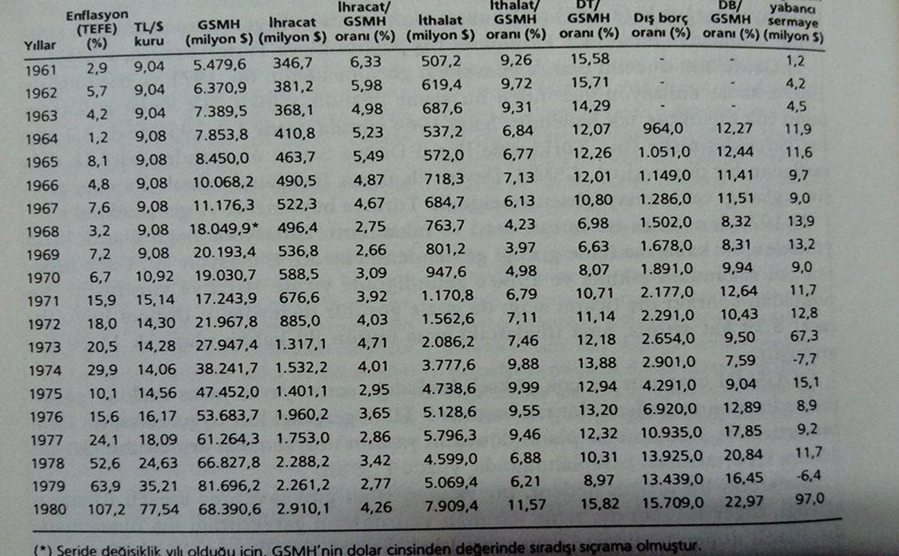
Internal Environment and Dynamics of Türkiye

Slide 12
Foreign Politics of the Period
It's fair to say that the unstable policies and unproductive political conflicts of the 1960s-1980s were not reflected in Turkey's foreign policy during this period.
These years were years of determined foreign policy and a period of true autonomy for Turkey, a Medium-Sized State (MSS).

Slide 13
Foreign Politics of the Period
The UN Assembly supported the granting of self-determination to Algeria.
A very appropriate response was given to the Johnson letter in 1964.
In 1965, the US policy towards Vietnam was opposed.
In the 1967 Arab-Israeli war, for the first time, Arabs were supported and Israel was not tolerated.
Throughout the 1970s, Turkey pursued a policy of constant tension with the US and Greece in the Aegean.
Poppy cultivation was legalized in 1974.

Slide 14
Foreign Politics of the Period
In 1974, Turkish Cypriot people were assured freedom (Cyprus Peace Operation).
Between 1974 and 1978, the US stood firm against the arms embargo.
In 1978 and 1979, a policy of rapprochement with the Non-Aligned Movement was pursued.
In the same year, a National Defense Doctrine was introduced.
In 1979, despite US insistence, Greece refused to return to NATO.
Until September 12, 1980, the US limited the use of its bases and controlled the flow of materials.
Laid the foundations of the National Defense Industry.

Slide 15
Foreign Politics of the Period
Turkey's stance, characterized by its backbone and character, did not change the general course of its foreign policy. Why?
There were many reasons. The main ones were:
  Western aid and loans, which continued until the mid-1970s. It received an average of $250-300 million in loans and foreign aid annually. This figure was more than half of its foreign trade.
  It was dependent on the West for arms purchases and spare parts. Discussions about leaving NATO were also interrupted by the USSR's intervention with tanks in Prague in 1968.
  It did not sever relations with Israel, did not turn its face to the West, and received financial aid from the Soviets, but did not lean towards the USSR camp.

Slide 16
Relations with USA and NATO
Turkey's relations with the US and NATO focused on the following key issues:
During the 1962 Cuban crisis, the crisis's emergence and resolution, and its most significant impact on Turkey, were that Turkey would learn a lesson from the Cuban crisis and abandon its one-sided foreign policy.

Slide 17
Relations with USA and NATO
The Cyprus issue and the Johnson Letter: This letter had a significant impact on Turkish-US relations for many years.
President Johnson's statement in 1964 that NATO would not defend Turkey against a Soviet attack if Turkey intervened in Cyprus strengthened the hand of NATO opponents, who argued that Türkiye should withdraw from NATO.
Following this letter, Turkey pursued a multilateral foreign policy.
A process of reconsidering Turkey's blindly pro-US policies began.
Efforts were made to develop a domestic arms industry and procure weapons from non-US sources.

Slide 18
Relations with USA and NATO
The Opium Problem: With the rise of drug use in the US in the 1960s (500,000 addicts in 1968), President Nixon began addressing the problem and called on drug-producing countries (10, mostly in Asia) to halt opium production.
Turkey resisted this, but did not cultivate opium for three years between 1971 and 1974.
Cultivation resumed in 1974, becoming a significant issue between the two countries, but it was overshadowed by the problems brought on by the Cyprus Peace Operation.

Slide 19
Relations with USA and NATO
The Cyprus Problem (1960-74): From the 1960s onward, Turkish-Greek relations would continue to be overshadowed by the Cyprus issue.
The Cyprus problem was resolved with the establishment of the Independent Republic of Cyprus in 1960, but Greek Cypriots also had the goal of Enosis (Unification) and constantly maintained it.
When the terrorist organization EOKA, aiming to unite Cyprus with Greece, began intimidation and killings on the island, the events continued in 1963, 1967, and beyond.
In 1974, when Nikos Sampson staged a military coup in Cyprus and began to achieve "Enosis," the goal of uniting Cyprus with Greece, Turkey landed on the island on July 20.
The second operation began on August 14 and achieved its goal on August 16. A ceasefire was declared, laying the foundations for Cyprus's current status.

Slide 20
Relations with Greece
The Cyprus Problem (1960-74): From the 1960s onward, Turkish-Greek relations would continue to be overshadowed by the Cyprus issue.
The Cyprus problem was resolved with the establishment of the Independent Republic of Cyprus in 1960, but Greek Cypriots also had the goal of Enosis (Unification) and constantly maintained it.
When the terrorist organization EOKA, aiming to unite Cyprus with Greece, began intimidation and killings on the island, the events continued in 1963, 1967, and beyond.
In 1974, when Nikos Sampson staged a military coup in Cyprus and began to achieve "Enosis," the goal of uniting Cyprus with Greece, Turkey landed on the island on July 20.
The second operation began on August 14 and achieved its goal on August 16. A ceasefire was declared, laying the foundations for Cyprus's current status.

Slide 21
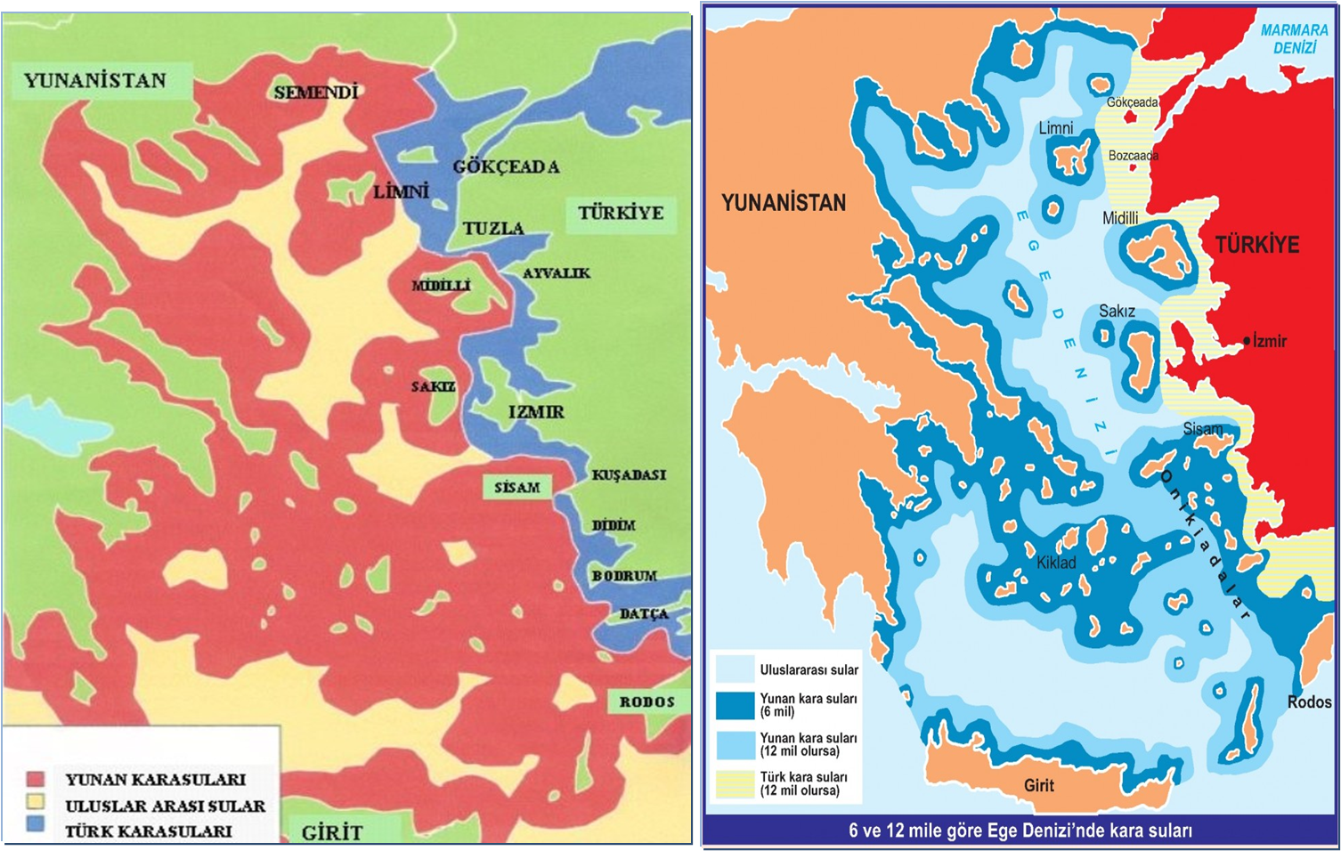
Relations with Greece

Slide 22
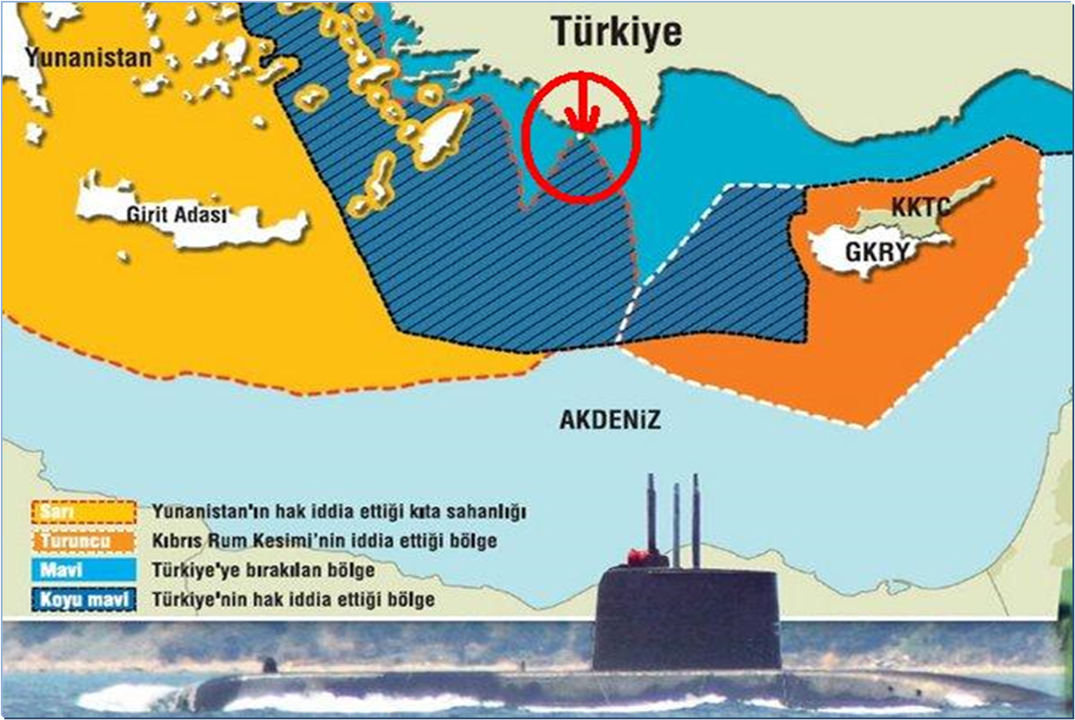
Relations with Greece
(continental shelf)

Slide 23
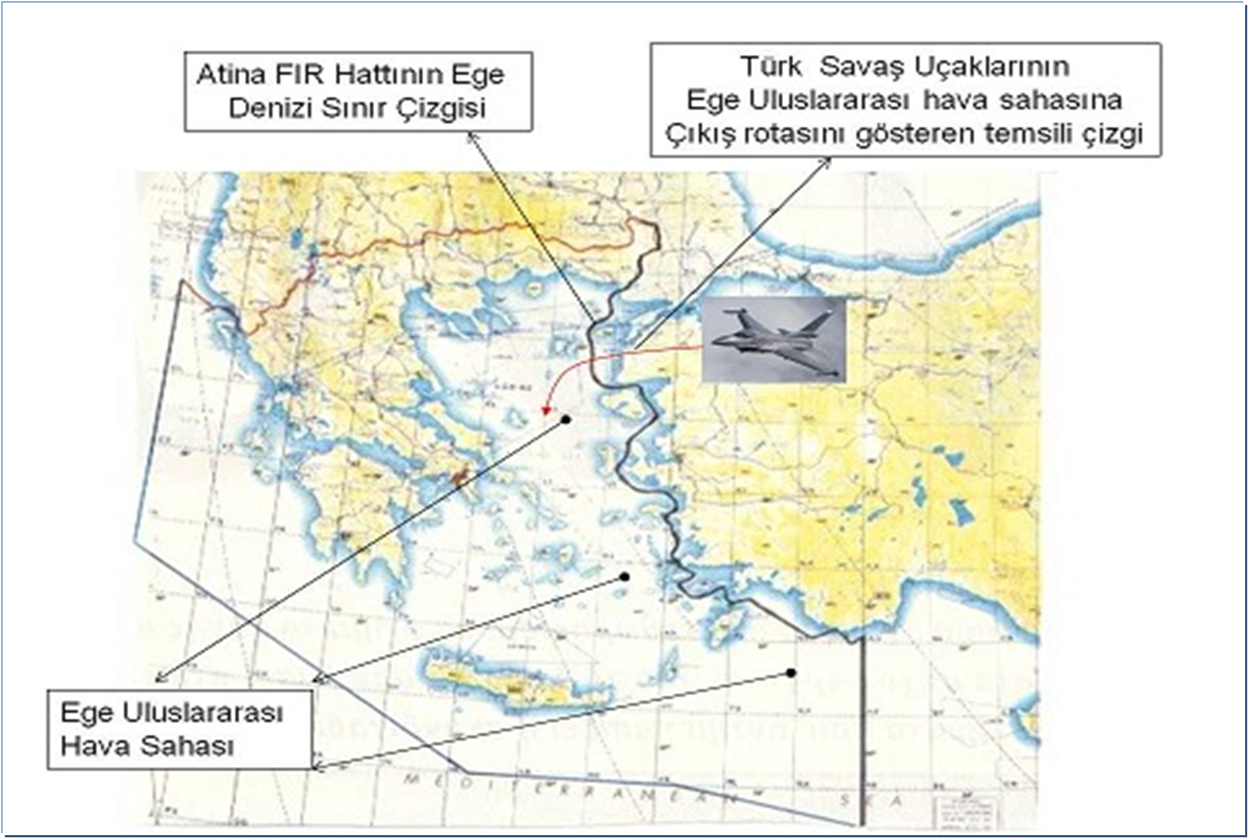
Relations with Greece
(airspace problem)

Slide 24
Relations with Greece
(demilitarization of the islands)
The issue of Greece's militarization of the Aegean islands has been a hot topic between the two countries since the 1970s.
The Treaty of Lausanne requires the islands to be demilitarized, but Greece occasionally violates this requirement.
The Kardak crisis, a similar one, occurred in 1996, bringing the two countries to the brink of war.

Slide 25
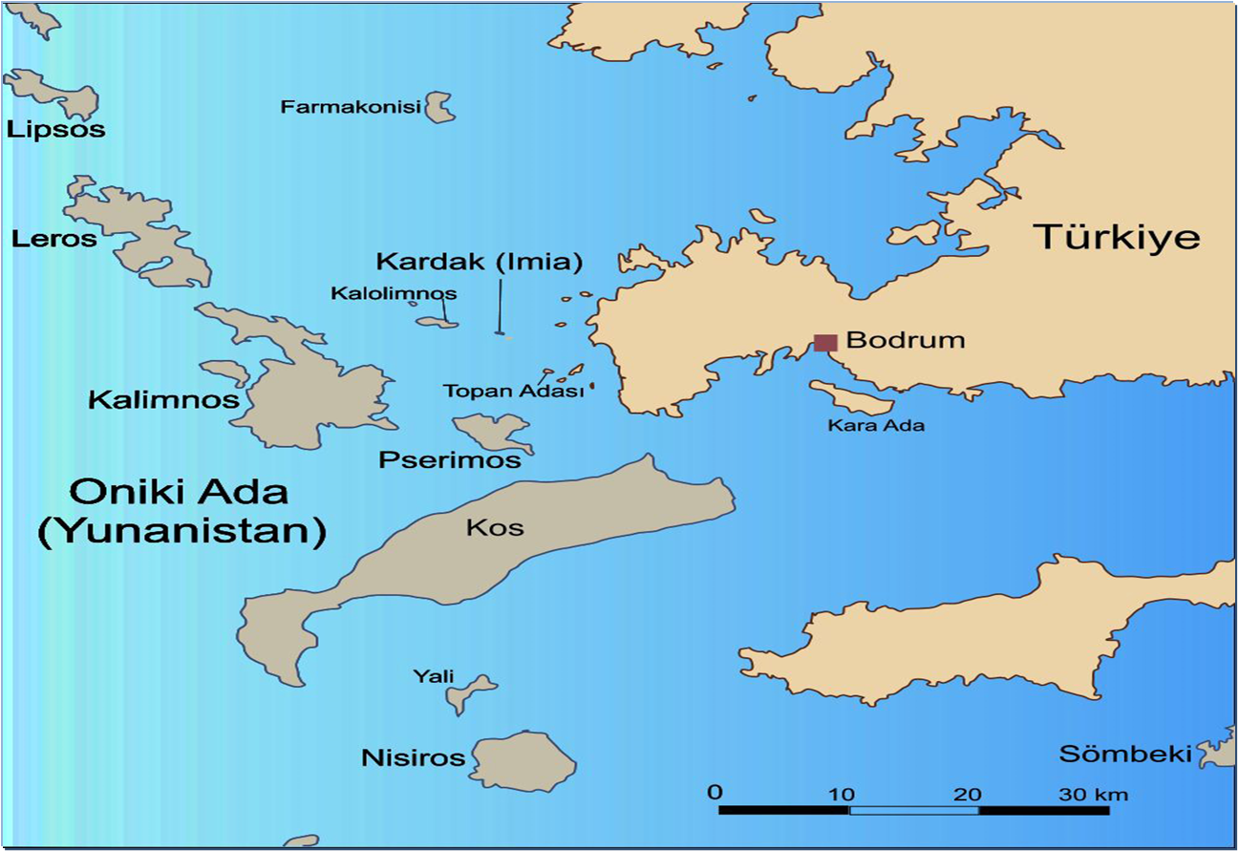
Relations with Greece
(kardak island problem)

Slide 26
Relations with USSR
The issue of Greece's militarization of the Aegean islands has been a hot topic between the two countries since the 1970s.
The Treaty of Lausanne requires the islands to be demilitarized, but Greece occasionally violates this requirement.
The Kardak crisis, a similar one, occurred in 1996, bringing the two countries to the brink of war.

Slide 27
Relations with USSR
The détente and Helsinki Final Act processes positively impacted relations between the two countries.
USSR leaders stated that the previous territorial and base demands were a mistake, and that this was a mistake made by the USSR leaders of the time. This led to a positive course in relations.
Positive economic relations, loans, and technical assistance received from the USSR also played a significant role in relations between the two countries.

Slide 28
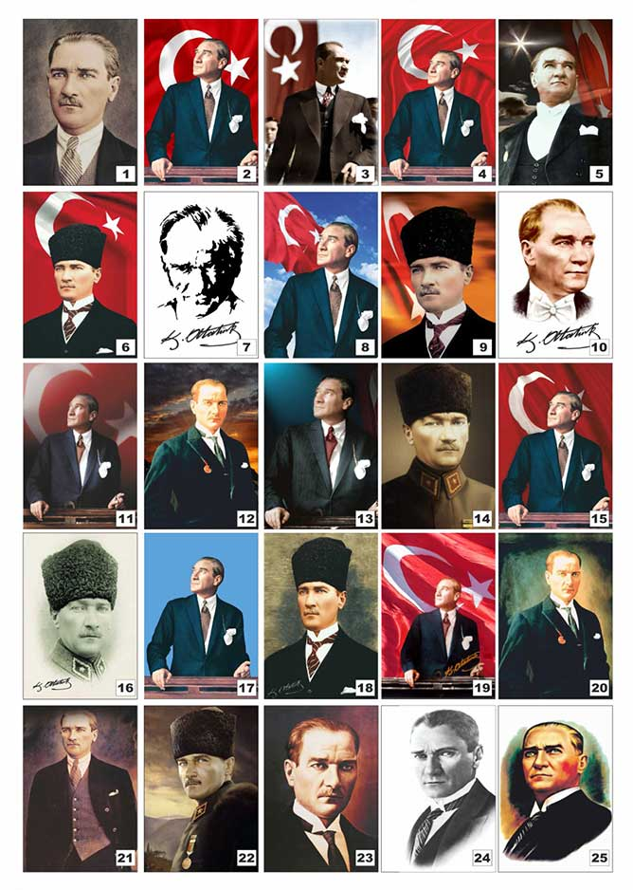
Questions?

